Slide 1
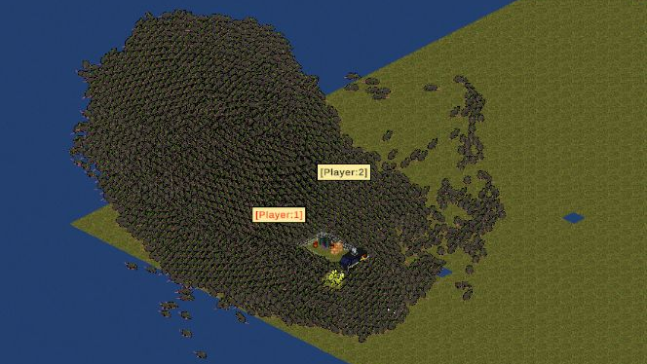
Pestis
Harvey, Murray, Shayaan, Vinh,
Chongsheng, Ani
Weekly review – 06/02/2025

Slide 2
23th - 30th Jan (1st week)
Added continuous development in git (different versions)
Combat implemented
Cheese implemented (resource)
Initial procedural generation added
Changed UI to work with adjusting screen sizes
Lighting for points of interest figured out

Slide 3
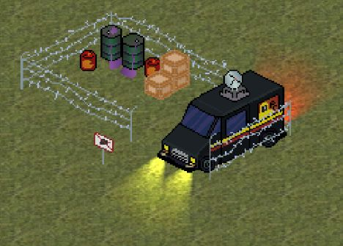
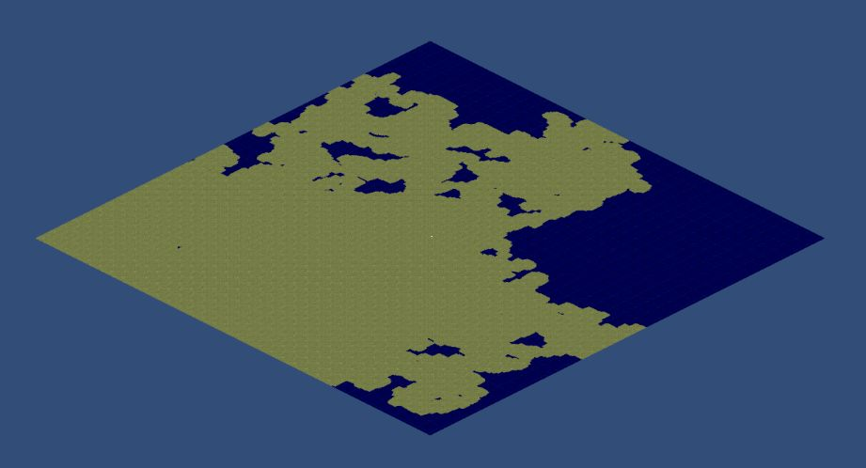
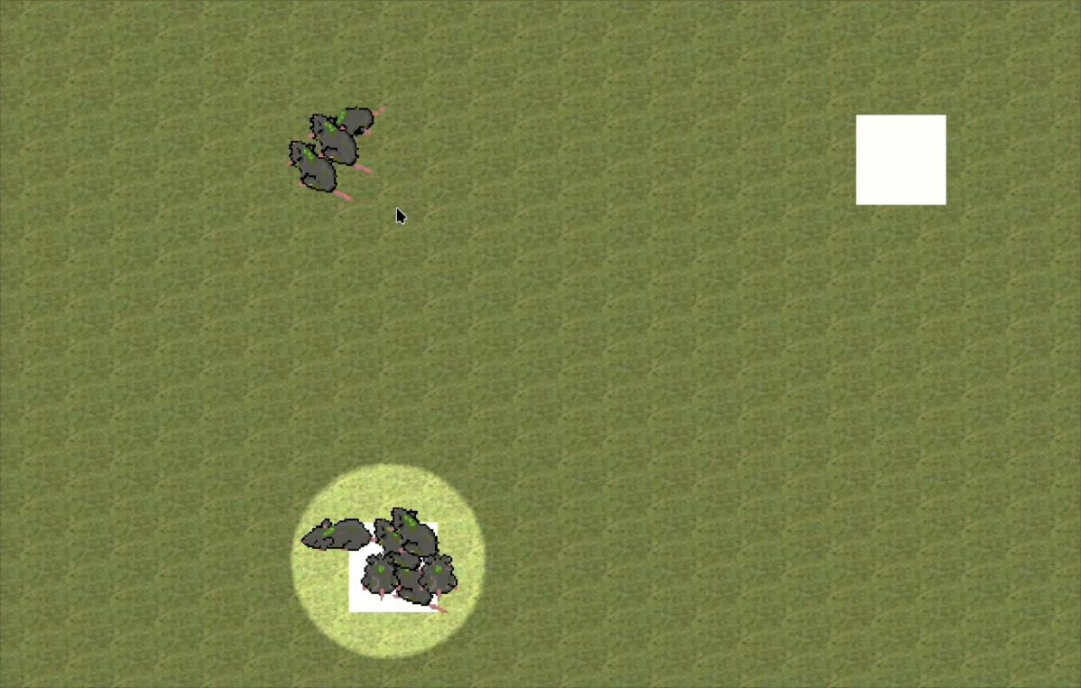
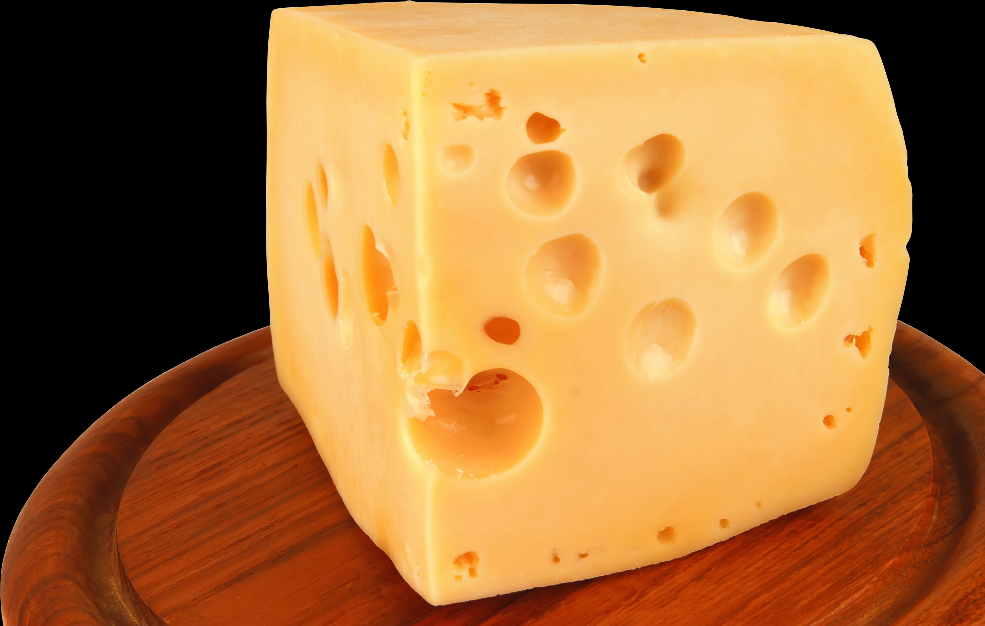

Slide 4
31st Jan – 6th Feb (Week 2)
Human patrols around POIs
Developed population model
Put UI in the game scene and connected functions
Cheese UI
Improved map generation to have biomes
Added UI information display
Added split horde function
Rat death animations added
Dev overlays
Player usernames
Shayaan got hypothermia 🥶

Slide 5
